Slide 1

VSB_PLUS
SCRUM#1

Slide 2

Project deats
What we are doing
A good design of the Visual Schedule Builder Plus that will help to organize and build up the
time table wisely.
Problem we are solving
1. what courses to take first to be able to graduate in time
2. knowing the different limitations of each course
3. which of elective classes to take that will benefit them in the future based on their
faculty
Gaps we are filling
1. advising system
2. detailing the course information
3. laid out the benefit elective classes based on different faculty
Innovation and Introduction to the world
1.classification into different faculty
2.based on the faculty, it will give out advice on the courses to take for the students
3.after the students have chosen and built up their desired time schedule, it also
gives some command on their time table to help them for better time planning

Slide 3

Project & documentation review
What we are currently working on
1. researching on the Visual Schedule Builder from different University(lots of University using same schedule builder) and get inspire from some schedule build Apps
2. brainstorm the most suitable UI design
3. note down helpful ideas
4. developing LoFi prototype
Demonstration
inspire by other product, roadmap(kanban),empathy map, data visualization sample , LoFi prototype
GitHub/Version control “stamp of approval”
https://github.com/yang242j/VSB_Plus

Slide 4

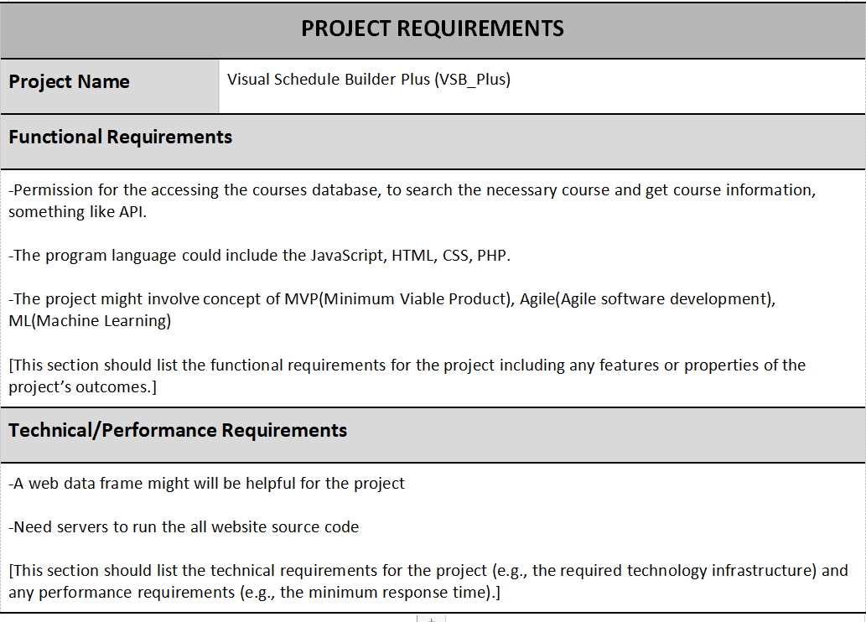

Project requirement

Slide 5
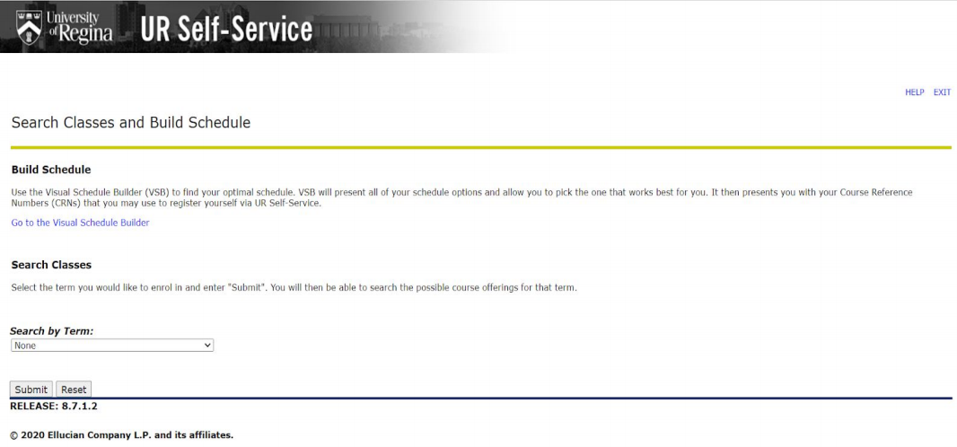
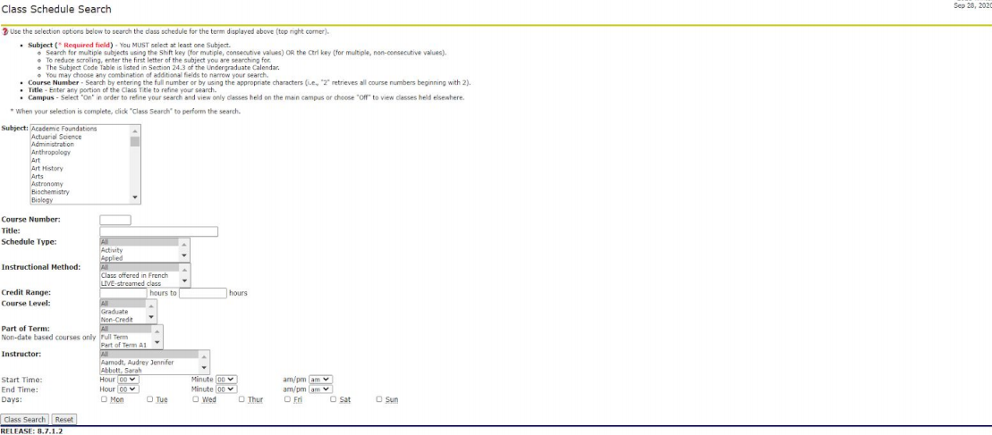
Inspires
It is a great search function! we can add more options to filter the course
for example , different faculties, most likes,views, most important course
Can also use these tags in advising system

Slide 6
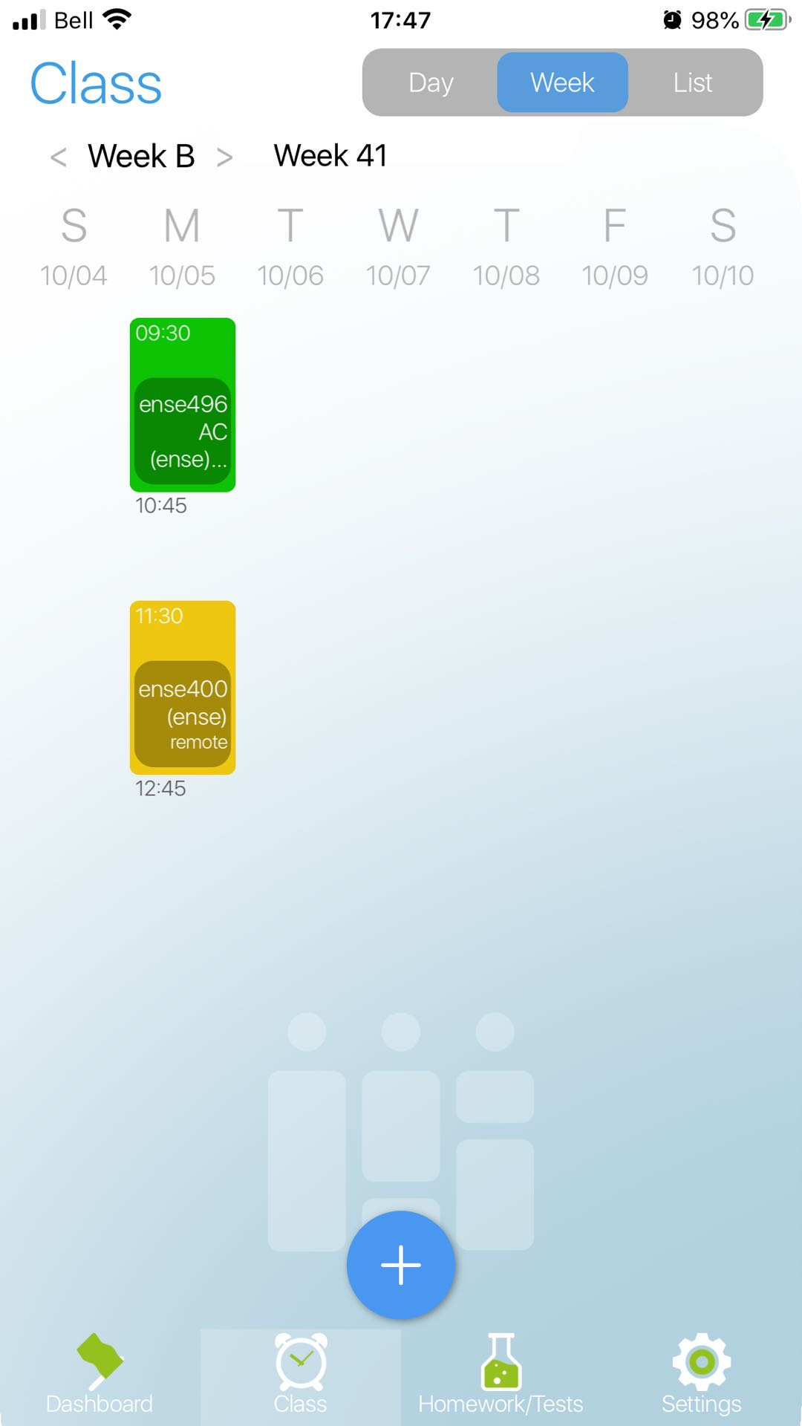
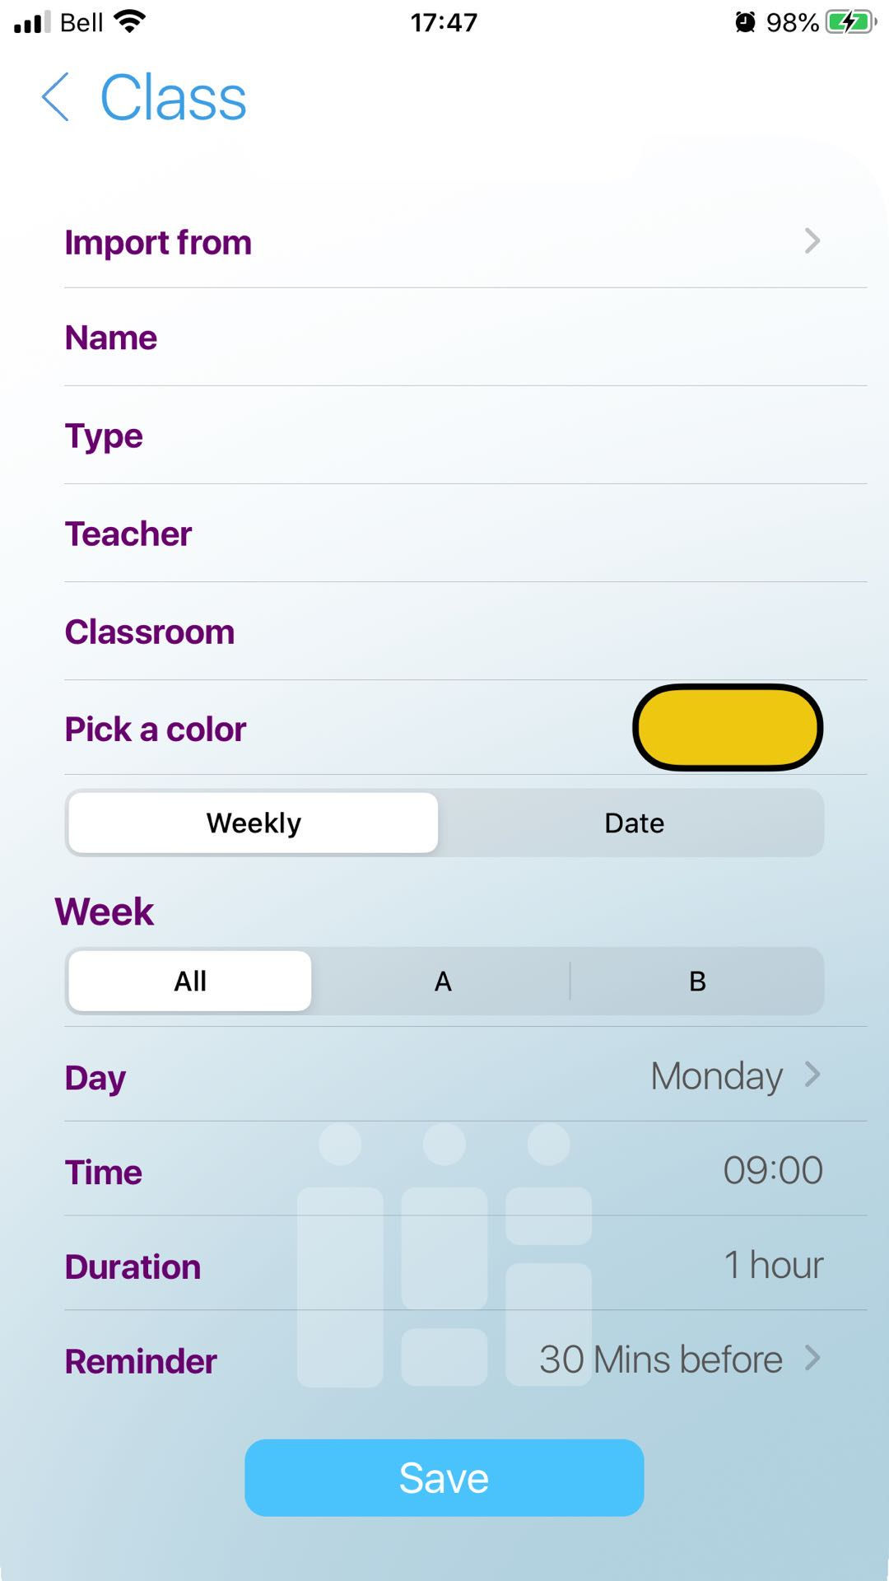
Inspires
We can use a add button to drag course form inventory, set color of class , add some comment
(holidays for example)
Screenshot from an app called studenttimetable

Slide 7
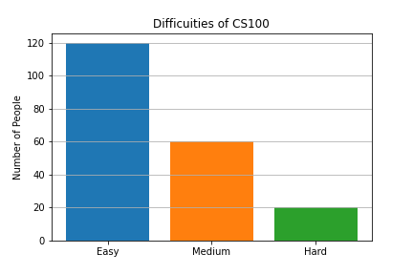
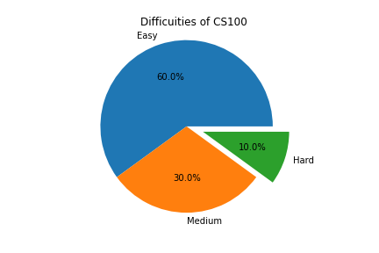
Data Visualization Sample
These chars are made by some simple python work with matplotlib.
Data is made up ,because we have not get any useful data yet, these are just a sample

Slide 8
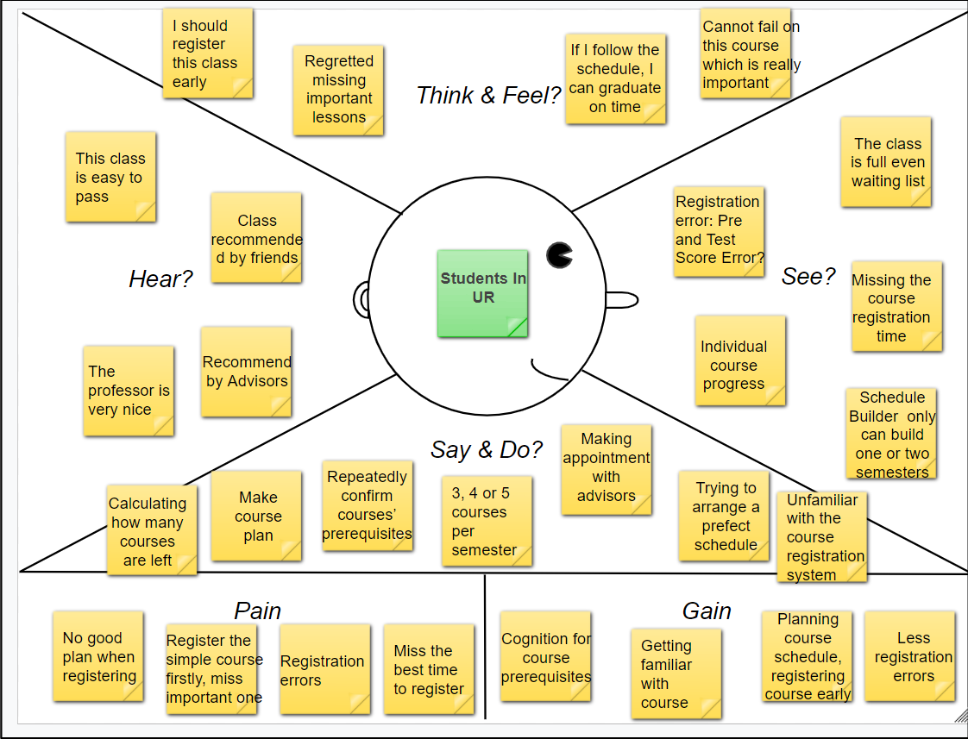
Empathy Map and Brainstorm file
BrainStorm File
Main Interface
drag courses to timetable
Default schedule : generate by system ,can be modified
Course recommend : right side box , according to the importance ,decide highly recommend or something else
Show Term Info
Modify different term
Show summer only winter only courses
The course type (elective /open elective /technical elective/required/….) give tags to courses and list it
Show final exam schedule
Filter class according the difficult /popularity/professor
Data visualize
Universities’ visual schedule builder and degree audit suggestion
Term is fixed , can not modified
Have to search the course and know about it before, can not get help directly form system
Search system should be more user friendly
Two interface patterns one is show more information, another filter the unwanted data
Give permission to student
Build a course relation tree(data visualization)

Slide 9
LoFi and Kanban
can be seen in Github
https://github.com/yang242j/VSB_Plus

Slide 10

Group reflection
01
02
03
Do you fell you are on track
Do you feel there are barriers to your success
Do you need any help going forward
Yes, we are are track. Because we set regular meeting every week and shar ideas on brainstorm files, most import is everyone is willing to participate
Yes， after we do some research on Visual Schedule Builder and degree Audit on Urcourses, they are doing very will on many aspects. The problem is they are not user friendly.
We need the data for different faculty. Need a scientific method to demonstrate classes

Slide 11
04
Question or concerns
Maybe we are not able to use machine learning technologies because lack of data

Slide 12
References
Uofr class schedule search
https://banner.uregina.ca:17023/ssbprod/bwskfcls.P_GetCrse

Slide 13
Thank you

